Slide 1
JUSTIN FLOYD
AI-First Technical Agile Delivery Professional
TS/SCI Poly · Platform Engineer · Federal IC Delivery
Cleared · AI-Native · Agile at Scale
Building the systems. Leading the programs. Shipping the results.
12+
TS/SCI
IC5
Years Delivering
Federal Solutions
Active Clearance
with Polygraph
The Level
I Operate At
Principal Technology Consultant · TS/SCI Poly · justinfloyd.dev

Slide 2
WHO I AM
The Short Version
Current Role
Technical Scrum Master /
Platform Developer, Athena TO6 (BAH)
I am a Technical Scrum Master and hands-on platform developer currently embedded on Athena Task Order 6 through Booz Allen Hamilton. My role spans both delivery leadership and active engineering — I do not manage from the sideline.
I built a certificate monitoring platform using Python, Kubernetes (Helm), and Terraform. I built the front-end. I shipped it. That project lit the fire for everything I have built since.
I run a team of AI agents in production. They have defined roles. They operate daily. This is not a proof of concept — it is how I work.
My clearance is active TS/SCI with Polygraph. I have been operating inside the IC for years. I understand the mission, the constraints, and what it takes to earn trust in that environment.
Clearance
TS/SCI — Active, CI Poly
Experience
12+ years federal &
commercial delivery
AI Posture
AI-first engineering,
production agent orchestration
Education
12+ yrs exp equivalent;
CSM, A-CSM, ICP-APM

Slide 3
WHAT I BRING TO THIS ROLE
Technical Credibility
Pre-Sales & Deal Influence
I build things. Certificate monitoring on K8s/Helm/Terraform. AI agent pipelines in production. Static platforms on GitLab Pages. I bring engineering substance to every customer conversation — not slide decks about cloud.
I translate complex mission requirements into architecture, scope, and business value. I have shaped delivery strategy and SOWs in high-stakes federal environments where trust and technical depth close the deal.
Executive Stakeholder Management
AI-First Delivery
I operate comfortably at the executive level inside the IC. I manage satisfaction, identify dissatisfaction early, and establish recovery actions before they become escalations.
I actively orchestrate AI agents in my daily workflow — assigning roles, managing outputs, iterating on outcomes. This is not theoretical. I can demonstrate it and I can help Microsoft customers adopt the same posture.
Clearance & IC Fluency
Delivery at Scale
Active TS/SCI with Polygraph. Athena Task Order 6 experience. I understand classification boundaries, compliance constraints, and how to deliver inside them without slowing down.
Led Agile programs with 5,000+ labor hours recaptured annually. Ran SAFe multi-team programs. Generated WBS and managed work streams end to end. I have seen both sides of the delivery lifecycle.

Slide 4
CAREER TIMELINE
Accenture &
Early Consulting
Bogart
Associates
Booz Allen
(Athena TO6)
Software Dev
& Integration
Scrum Master
& Tech Lead
Tech SM /
Platform Dev
2017–2019
2022–2024
2011–2017
2019–2022
2024–Now
Na Alii /
Definitive Logic
Airlines
Reporting Corp
Full-Stack Dev
DevOps
SM / Jira Admin
Process Automation
From developer → DevOps → Scrum Master → Technical Lead → AI-First Platform Engineer — Athena TO6

Slide 5
AI & PLATFORM ENGINEERING
Platform Built on Athena TO6
AI-First Engineering Practice
Certificate Information Monitor — Python service surfacing expiry, chain, and health data across the environment
Operates a managed team of AI agents with defined roles — not a chatbot, a workflow
Kubernetes deployment via Helm charts and Terraform IaC — production-grade, repeatable
Agents operate daily across development, review, and delivery tasks
GitLab Pages static frontend for team-wide operational visibility with zero infrastructure overhead
LLM integration (Claude API) embedded into platform and product tooling
Automated alerting and monitoring pipelines reducing manual toil
Capable of demonstrating production agent orchestration on request
Architecture decision: IaC-first approach using Terraform + additional IaC tooling for full lifecycle management
Applies AI-first methodology to accelerate cloud adoption and technology consumption at scale — this is not a pitch, it is a track record

Slide 6

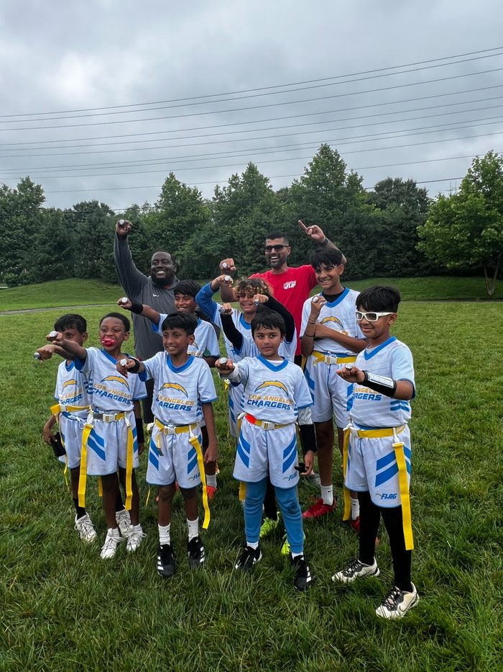
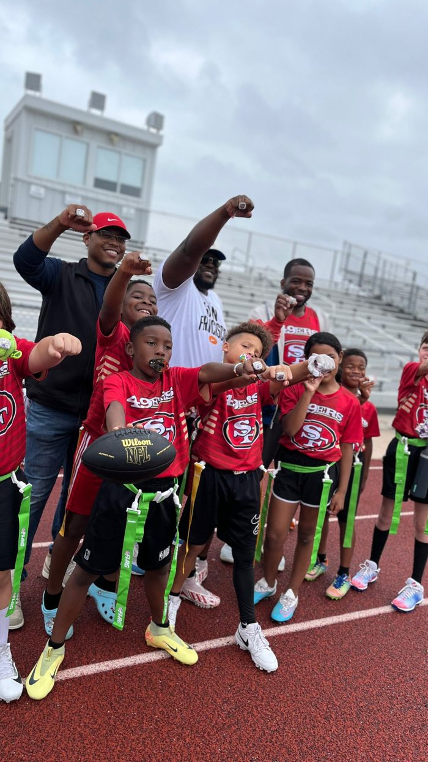
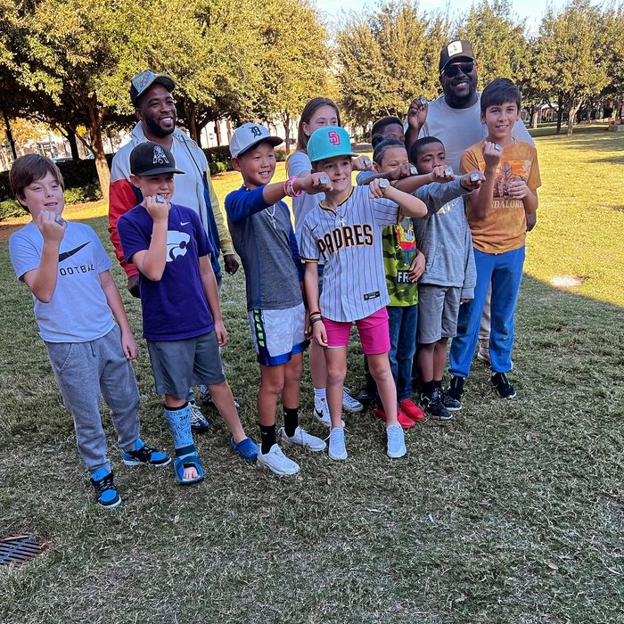
THE WINNING STANDARD
4 CHAMPIONSHIPS · 3x TEXAS · 1x VIRGINIA
Legacy Seven United
Co-Founder · Texas · 501(c)(3) Pending
Virginia Championship
Texas Championship
Frisco Elite · Texas
1x · Chantilly, VA
3x · Frisco, TX
Championship · Rings Out
16 yrs coaching · Single father
Systems build winners.
Systems and culture travel. Individual talent does not. — The same principle that wins championships builds delivery programs.

